Slide 1
Railway Management System
Group 2A - E
Fida Kamal 180041208
Shah Jawad Islam 180041223
Alvi Aveen Khan 180041229

Slide 2
Introduction
The project attempts to create a database management system to supervise, control and update various parts of the national railway system. Additionally, non-administrative access is also available for customers to manage bookings.
This project could serve as a starting point for a proper management system, since it provides the basic features and is extensible.

Slide 3
Features
Administrative
Non-Administrative
General
Add stations and trains to the database
View information about purchased tickets for different trains
Book tickets on different trains
View information about purchased tickets for a particular customer
View schedules for different stations

Slide 4
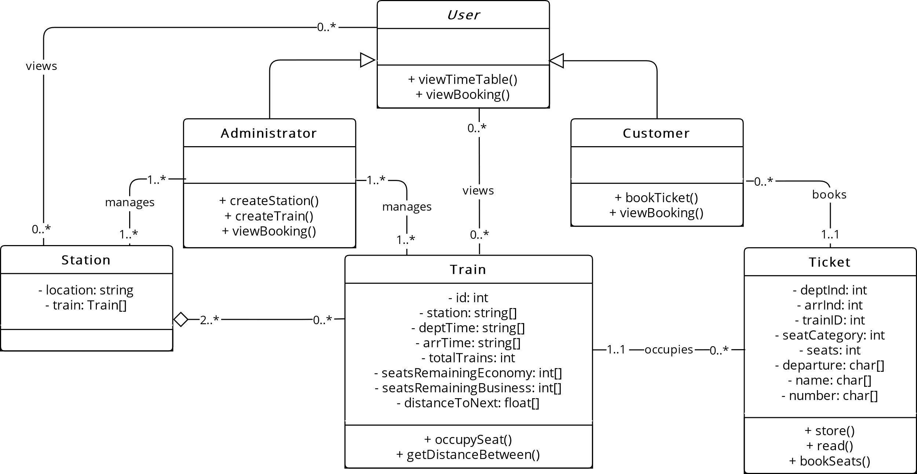
UML Diagram

Slide 5
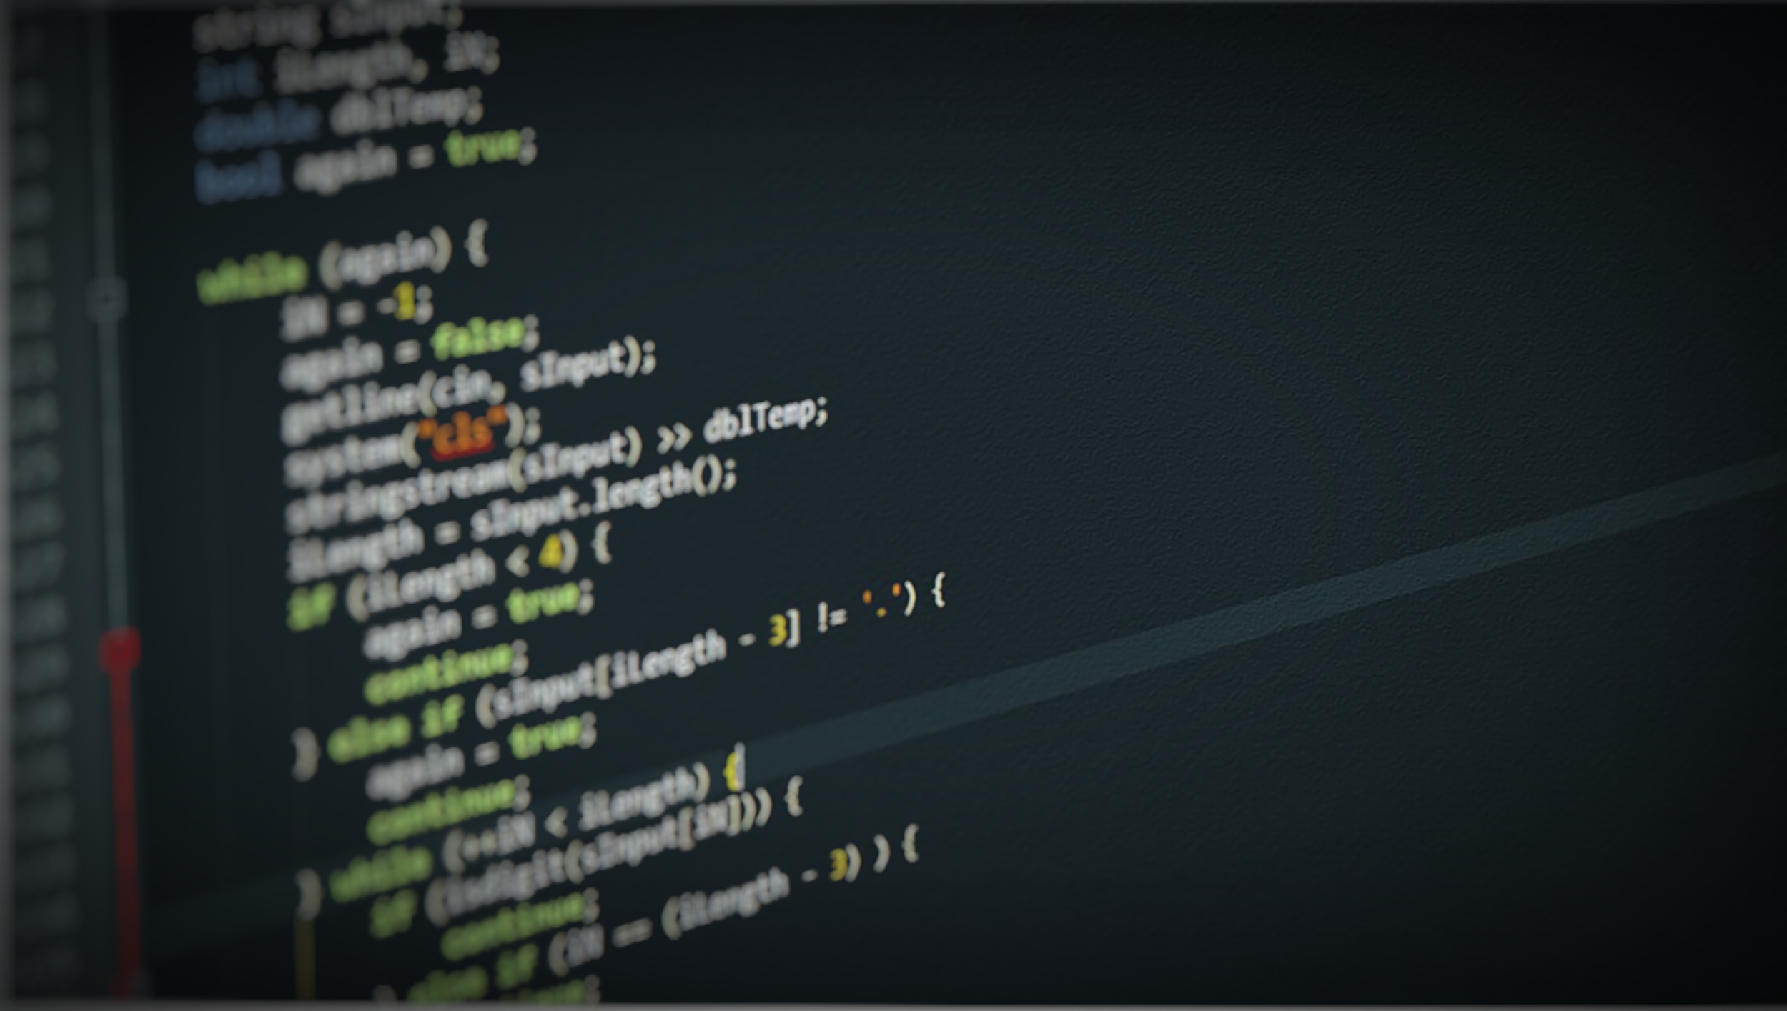
Project Demonstration

Slide 6
Challenges
Time constraints caused project to fall short of team’s expectations.
Not using a version control system made it difficult to synchronize and handle errors.
Predicting and resolving errors related to scheduling in a railway system proved more difficult than anticipated.
A file-based database made it difficult to keep everything consistent and error-free.

Slide 7
Future Work
Login page for administrators
Removing trains and stations from the database
Accommodating delays and revisions to the schedule
Cancelling bookings
Extend the existing system to accommodate different schedules for different dates

Slide 8
Thank You!

